Slide 1
Chapter 10: Compiling and link-editing a program on z/OS

Slide 2

Chapter objectives
Screenshot 1
Be able to:
Explain the purpose of a compiler
Compile a source program
Create executable code from a compiled program
Explain the difference between an object module and a load module
Run a program on z/OS

Slide 3
Key terms in this chapter
binder
copybook
linkage-editor
load module
object module
object-oriented code
procedure
procedure library
program library
relocatable
source module

Slide 4
Source, object, and load modules
A source program can be divided into logical units – or modules -- that perform specific functions.
Each module is assembled or compiled by one of the language translators
Input to a language translator is a source module
Output from a language translator is an object module
Object modules must be processed by the binder before they can be executed
Output of the binder is a load module.
Notes:
Use this foil and the next one together.

Slide 5
Source code to load module
Notes:
To be used with the previous foil

Slide 6
Object module
An object module:
  Is a collection of one or more compilation units produced by an assembler, compiler, or other language translator and used as input to the binder (or linkage editor)
  Is in relocatable format with machine code that is not executable
  Is stored in an object library

Slide 7
Load module
A load module:
  is also relocatable, but with executable machine code
  is in a format that can be loaded into virtual storage and relocated by program manager, a program that prepares load modules for execution by loading them at specific storage locations.

Slide 8
More about object modules and load modules
Object modules and load modules consist of:
  Information (control dictionaries) to resolve cross-references between sections of different modules
  Text, containing the instructions and data of the program
  An end-of-module indication (END statement)

Slide 9
What are source libraries?
Source programs are stored in a PDS known as source library
Source libraries contain the source code to be:
  submitted for a compilation process
  retrieved for modification by an application programmer
A copybook is a source library containing prewritten text; it is used to copy text into a source program, at compile time.

Slide 10
Compiling programs on z/OS
Compilers:
  Translate source code into object code
  Assign relative addresses to all instructions, data elements, and labels, starting from zero (required in a virtual storage operating system)
Addresses are in the form of a base address plus a displacement (to allow programs to be relocated)
References to external programs or subroutines are left as unresolved
Notes:
Relocatable - programs do not have to be loaded into the same location in storage each time that they are executed.
Unresolved external references will either be resolved when the object module is linked or dynamically when the program is executed.

Slide 11
Compiling programs on z/OS
Various ways to compile programs on z/OS:
  batch job
  under TSO/E through commands, CLISTs, or ISPF panels
  for COBOL programs, you can compile programs in a z/OS UNIX shell by using the cob2 command.
Notes:
Relocatable - programs do not have to be loaded into the same location in storage each time that they are executed.
Unresolved external references will either be resolved when the object module is linked or dynamically when the program is executed.

Slide 12
Compilation step
Define the data sets needed for the compilation
Also, specify any compiler options needed by the program

Slide 13
Compilation step – example
Data set (library) that contains the source code is specified on the SYSIN DD statement:
//SYSIN DD DSNAME=dsname,
// DISP=SHR
You can place source code directly in the input stream - use this SYSIN DD statement:
//SYSIN DD *

Slide 14
Compiling with cataloged procedures (PROCs)
A common way to compile a program under z/OS is by using a batch job with a cataloged procedure or PROC
A PROC contains a set of JCL statements placed in a data set called the procedure library (PROCLIB)
The PROC must include the following information:
  Job description
  Execution statement to invoke the compiler
  Definitions for the data sets needed but not supplied by the PROC

Slide 15
Sample JCL for compiling a COBOL source program inline…
//COMP JOB
//COMPILE EXEC IGYWC
//SYSIN DD *
IDENTIFICATION DIVISION (source program)
.
.
.
/*
//

Slide 16
COBOL compile, link & go PROC
JCL in next slide executes the IGYWCLG PROC
PROC is a three-step procedure for compiling a source program, linking it into a load library and executing the load module
  The first two steps are the same as those in the compile and link example
  We do not need to permanently save the load module in order to execute it
Result of running the JCL is to:
  compile our inline source program
  link-edit the object code
  store the load module (either temporarily or permanently)
  execute the load module
Notes:
CLG is compile, link and go.
Use the next two foils with this foil.

Slide 17
Executing COBOL CLG PROC
//CLGO JOB
//CLG EXEC IGYWCLG
//COBOL.SYSIN DD *
IDENTIFICATION DIVISION (source program)
.
.
.
/*
[//LKED.SYSLMOD DD DSN=MY.LOADLIB(PROG1),DISP=OLD]
Notes:
The override to the SYSLMOD DD statement is optional
If coded, the load module PROG1 will be permanently saved in MY.LOADLIB
If not coded, the load module will be saved in a temporary data set and deleted after the GO step

Slide 18
COBOL CLG PROC
//IGYWCLG PROC LNGPRFX='IGY.V2R1M0',SYSLBLK=3200,
// LIBPRFX='CEE',GOPGM=GO
//*
//* COMPILE, LINK EDIT AND RUN A COBOL PROGRAM
//*
//* PARAMETER DEFAULT VALUE USAGE
//* LNGPRFX IGY.V2R1M0
//* SYSLBLK 3200
//* LIBPRFX CEE
//* GOPGM GO
//*
//* CALLER MUST SUPPLY //COBOL.SYSIN DD ...
//*
//COBOL EXEC PGM=IGYCRCTL,REGION=2048K
//STEPLIB DD DSNAME=&LNGPRFX..SIGYCOMP,
// DISP=SHR
//SYSPRINT DD SYSOUT=*
//SYSLIN DD DSNAME=&&LOADSET,UNIT=VIO,
// DISP=(MOD,PASS),SPACE=(TRK,(3,3)),
// DCB=(BLKSIZE=&SYSLBLK)
//SYSUT1 DD UNIT=VIO,SPACE=(CYL,(1,1))
//SYSUT2 DD UNIT=VIO,SPACE=(CYL,(1,1))
//SYSUT3 DD UNIT=VIO,SPACE=(CYL,(1,1))
//SYSUT4 DD UNIT=VIO,SPACE=(CYL,(1,1))
//SYSUT5 DD UNIT=VIO,SPACE=(CYL,(1,1))
//SYSUT6 DD UNIT=VIO,SPACE=(CYL,(1,1))
//SYSUT7 DD UNIT=VIO,SPACE=(CYL,(1,1))
//LKED EXEC PGM=HEWL,COND=(8,LT,COBOL),REGION=1024K
//SYSLIB DD DSNAME=&LIBPRFX..SCEELKED,
// DISP=SHR
//SYSPRINT DD SYSOUT=*
//SYSLIN DD DSNAME=&&LOADSET,DISP=(OLD,DELETE)
// DD DDNAME=SYSIN
//SYSLMOD DD DSNAME=&&GOSET(&GOPGM),SPACE=(TRK,(10,10,1)),
// UNIT=VIO,DISP=(MOD,PASS)
//SYSUT1 DD UNIT=VIO,SPACE=(TRK,(10,10))
//GO EXEC PGM=*.LKED.SYSLMOD,COND=((8,LT,COBOL),(4,LT,LKED)),
// REGION=2048K
//STEPLIB DD DSNAME=&LIBPRFX..SCEERUN,
// DISP=SHR
//SYSPRINT DD SYSOUT=*
//CEEDUMP DD SYSOUT=*
//SYSUDUMP DD SYSOUT=*

Slide 19
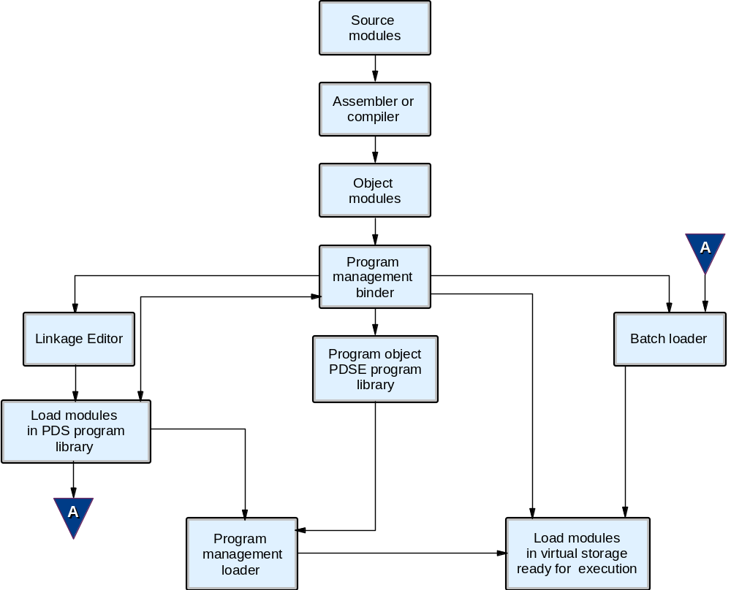
Load module creation and loading
Notes:
The figure shows how the program management components work together and how each one is used to prepare an executable program. We have already discussed some of them like source and object modules, so we can follow with the rest of them.

Slide 20
Linkage Editor
The linkage editor prepares a load module to be brought into real storage for execution
As input, the linkage editor accepts object modules, control statements, and user-specified input.
Output of the linkage editor is:
  A load module placed in a library (a PDS) as a named member
  Diagnostic output produced as a sequential data set

Slide 21
How a load module is created
The linkage editor assign virtual storage addresses to control sections of the module and resolves references between them.
The output load module contains the input object modules and input load modules processed by the linkage editor
The load module also contains the text from each input module, and an end-of-module indicator

Slide 22
Using the binder
Performs all of the functions of the linkage editor
Can also process program objects stored in PDSE data sets
Binder removes restrictions of the linkage editor
Input can include traditional data sets and z/OS UNIX files

Slide 23
Binder sample
Link-edits an object module
The output from the LKED step will be placed in a private library identified by the SYSLMOD DD
The input is passed from a previous job step to a binder job step in the same job (for example, the output from the compiler is direct input to the binder)
. . .
//LKED EXEC PGM=IEWL,PARM='XREF,LIST', IEWL is IEWBLINK alias
// REGION=2M,COND=(5,LT,prior-step)
//*
//* Define secondary input
//*
//SYSLIB DD DSN=language.library,DISP=SHR optional
//PRIVLIB DD DSN=private.include.library,DISP=SHR optional
//SYSUT1 DD UNIT=SYSDA,SPACE=(CYL,(1,1)) ignored
//*
//* Define output module library
//*
//SYSLMOD DD DSN=program.library,DISP=SHR required
//SYSPRINT DD SYSOUT=* required
//SYSTERM DD SYSOUT=* optional
//*
//* Define primary input
//*
//SYSLIN DD DSN=&&OBJECT,DISP=(MOD,PASS) required
// DD * inline control statements
INCLUDE PRIVLIB(membername)
NAME modname(R)
/*
Notes:
Explanation of example: EXEC
Binds a program module and stores it in a program library
(Alternative names for IEWBLINK are IEWL, LINKEDIT, HEWL, and HEWLH096)
The PARM field option requests a cross-reference table and a module map to be produced on the diagnostic output data set
SYSUT1
Defines a temporary direct access data set to be used as the intermediate data set
SYSLMOD
Defines a temporary data set to be used as the output module library
SYSPRINT
Defines the diagnostic output data set, which is assigned to output class A
SYSLIN
Defines the primary input data set, &&OBJECT, which contains the input object module
(this data set was passed from a previous job step and is to be passed at the end of this job step)
INCLUDE
Specifies sequential data sets, library members, or z/OS UNIX files that are to be sources of additional input for the binder
In this case a member of the private library PRIVLIB
NAME
Specifies the name of the program module created from the preceding input modules, and serves as a delimiter for input to the program module
(R) indicates that this program module replaces an identically named module in the output module library

Slide 24
Creating load modules for executable programs
A load module is an executable program stored in a partitioned data set program library
Creating a load module to execute only will require that you use a batch loader or program management loader
Creating a load module that can be stored in a program library requires that you use the binder or linkage editor

Slide 25
Creating load modules for executable programs (continued)
In all cases, the load module is relocatable
  That is, it can be located at any address in virtual storage within the confines of the residency mode (RMODE)
Relocatable programs allow an identical copy of a program to be loaded in many different address spaces, each being loaded at a different starting address

Slide 26
Batch loader
The batch loader:
Performs link-editing and loading into one job step
Accepts object modules and load modules, and loads them into virtual storage for execution
Prepares the executable program in storage and passes control to it directly
The batch loader is replaced by the binder in later releases of z/OS.

Slide 27
Program management loader
The program management loader:
  can load program objects
  reads both program objects and load modules into virtual storage and prepares them for execution
  resolves any address constants in the program to point to the appropriate areas in virtual storage and supports the 24-bit, 31-bit and 64-bit addressing ranges

Slide 28
Compile, link & execute JCL
//USUAL JOB A2317P,'COMPLGO'
//ASM EXEC PGM=IEV90,REGION=256K, EXECUTES ASSEMBLER
// PARM=(OBJECT,NODECK,'LINECOUNT=50')
//SYSPRINT DD SYSOUT=*,DCB=BLKSIZE=3509 PRINT THE ASSEMBLY LISTING
//SYSPUNCH DD SYSOUT=B PUNCH THE ASSEMBLY LISTING
//SYSLIB DD DSNAME=SYS1.MACLIB,DISP=SHR THE MACRO LIBRARY
//SYSUT1 DD DSNAME=&&SYSUT1,UNIT=SYSDA, A WORK DATA SET
// SPACE=(CYL,(10,1))
//SYSLIN DD DSNAME=&&OBJECT,UNIT=SYSDA, THE OUTPUT OBJECT MODULE
// SPACE=(TRK,(10,2)),DCB=BLKSIZE=3120,DISP=(,PASS)
//SYSIN DD * inline SOURCE CODE
. . . Source Code
//LKED EXEC PGM=HEWL, EXECUTES LINKAGE EDITOR
// PARM='XREF,LIST,LET',COND=(8,LE,ASM)
//SYSPRINT DD SYSOUT=* LINKEDIT MAP PRINTOUT
//SYSLIN DD DSNAME=&&OBJECT,DISP=(OLD,DELETE) INPUT OBJECT MODULE
//SYSUT1 DD DSNAME=&&SYSUT1,UNIT=SYSDA, A WORK DATA SET
// SPACE=(CYL,(10,1))
//SYSLMOD DD DSNAME=&&LOADMOD,UNIT=SYSDA, THE OUTPUT LOAD MODULE
// DISP=(MOD,PASS),SPACE=(1024,(50,20,1))
//GO EXEC PGM=*.LKED.SYSLMOD,TIME=(,30), EXECUTES THE PROGRAM
// COND=((8,LE,ASM),(8,LE,LKED))
//SYSUDUMP DD SYSOUT=* IF FAILS, DUMP LISTING
//SYSPRINT DD SYSOUT=*, OUTPUT LISTING
// DCB=(RECFM=FBA,LRECL=121)
//OUTPUT DD SYSOUT=A, PROGRAM DATA OUTPUT
// DCB=(LRECL=100,BLKSIZE=3000,RECFM=FBA)
//INPUT DD * PROGRAM DATA INPUT
data
//
Notes:
In this example, for a better understanding we have a compile, link-edit and execute job; in this case for an assembler program. In the step ASM (compile)
SYSIN DD is for the inline source code
SYSLIN DD is for the output object module
In the step LKED (linkage-edition)
SYSLIN DD is for the input object module
SYSLMOD DD is for the output load module
In the step GO (execute the program)
the EXEC JCL statement states that it will execute a program identified in the SYSLMOD DD statement of the previous step
All of the JCL has been coded inline
It should be noted that we could have used an existing JCL procedure or coded one and then only supplied the overrides, such as the INPUT DD statement

Slide 29
Load library
A load library contains programs ready to be executed
A load library can be one of the following:
  System library
  Private library
  Temporary library

Slide 30
System library
Unless a job or step specifies a private library, the system searches for a program in the system libraries when you code:
//stepname EXEC PGM=program-name
The system looks in the libraries for a member with a name or alias that is the same as the specified program-name
The most used system library is SYS1.LINKLIB, which contains executable programs that have been processed by the linkage editor

Slide 31
Private library
Private libraries are useful for storing programs too seldom needed to be stored in a system library
User-written programs are usually stored as members in a private library
To indicate that a program is in a private library, you code the DD statement defining the library with JOBLIB or STEPLIB
Result: The system searches for the program to be executed in the library defined by the JOBLIB or STEPLIB DD statement before searching in the system libraries.

Slide 32
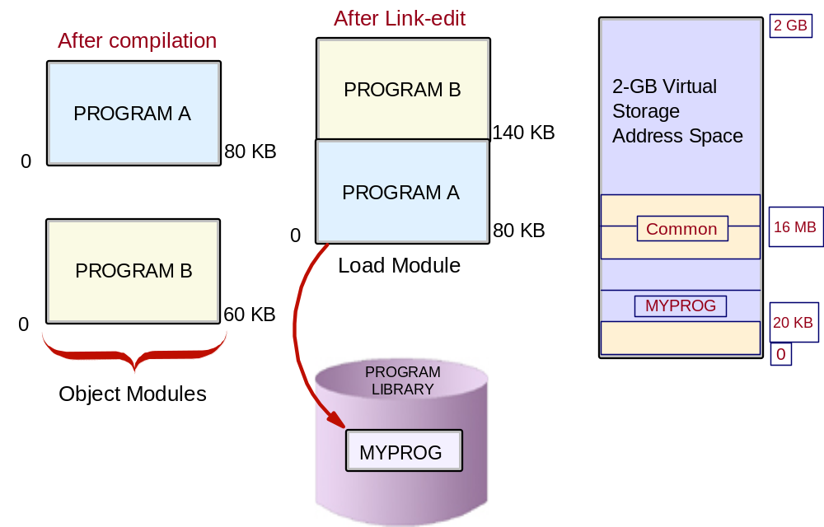
Overview of compilation to execution
Notes:
Explanation of example:
We start with two programs: A and B, which are compiled into two object modules. Then the two object modules are linked into one load module call MYPROG, which is stored in a load library on direct access storage. The load module MYPROG is then loaded into central storage by the program management loader and control is transferred to it to for execution.

Slide 33
Using procedures
Screenshot 2
Saves time and prevents errors
Consist of job control statements placed in a PDS or PDSE known as a procedure library
When stored in the system procedure library SYS1.PROCLIB (or an installation-defined procedure library) is called a cataloged procedure
A procedure in an input stream is called an inline procedure
Limit of 15 inline procedures per job.

Slide 34
Sample definition of a procedure
//DEF PROC STATUS=OLD,LIBRARY=SYSLIB,NUMBER=777777
//NOTIFY EXEC PGM=ACCUM
//DD1 DD DSNAME=MGMT,DISP=(&STATUS,KEEP),UNIT=3400-6,
// VOLUME=SER=888888
//DD2 DD DSNAME=&LIBRARY,DISP=(OLD,KEEP),UNIT=3350,
// VOLUME=SER=&NUMBER
Notes:
Three symbolic parameters are defined in this cataloged procedure:
&STATUS
&LIBRARY
&NUMBER
Values are assigned to the symbolic parameters on the PROC statement
These values are used if the procedure is called and no values are assigned to the symbolic parameters on the calling EXEC statement

Slide 35
Summary
The basic steps for turning a source program into an executable load module are:
  compile
  link-edit
  bind
The compile step translates source code into relocatable machine language, in the form of object code.
Object code must be processed by a binder (or linkage editor or loader) before it can be executed.

Slide 36
Summary (continued)
The binder resolves unresolved references in the object code and ensures that everything needed by the program is included in the final load module.
To execute a load module, the binder loads the module into real storage and then transfers control to it to begin execution.

